Slide 1

Computer Organization and Assembly Language
Lecture 3
Amir Nawaz

Slide 2
Today we will learn?
Flag register and its types

Slide 3
Flag Register
Flag register contains 16 bits that show the status of some activities.
Logical and Arithematic operations/instructions will change the flag status.
A flag is a single bit of information whose meaning is independent from any other bit.

Slide 4
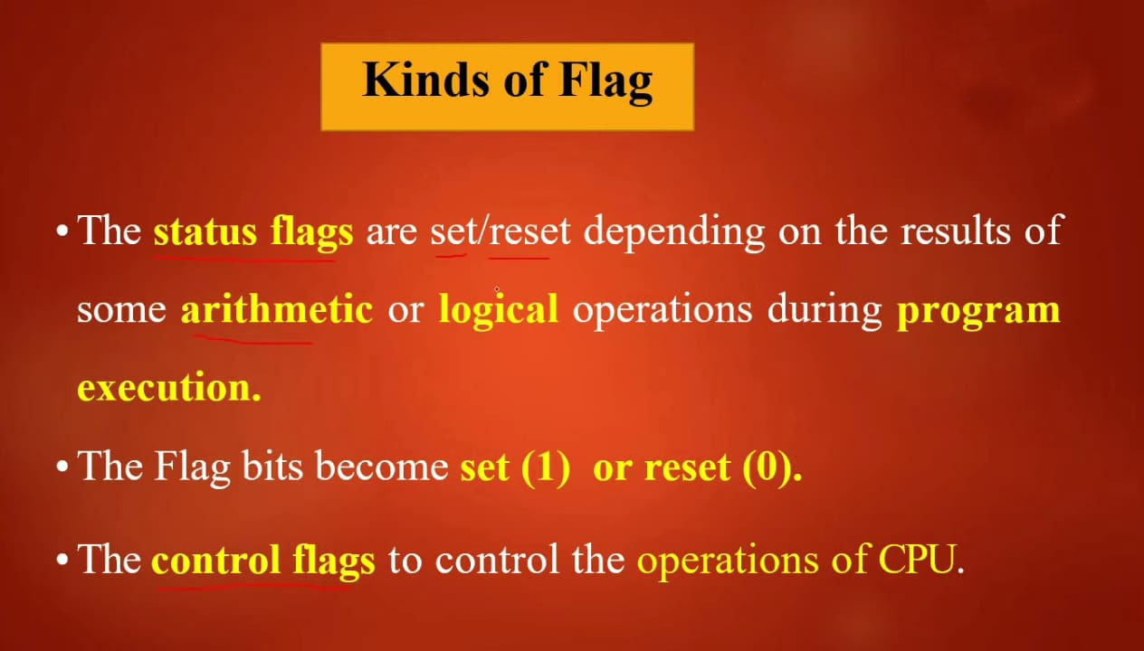

Slide 5
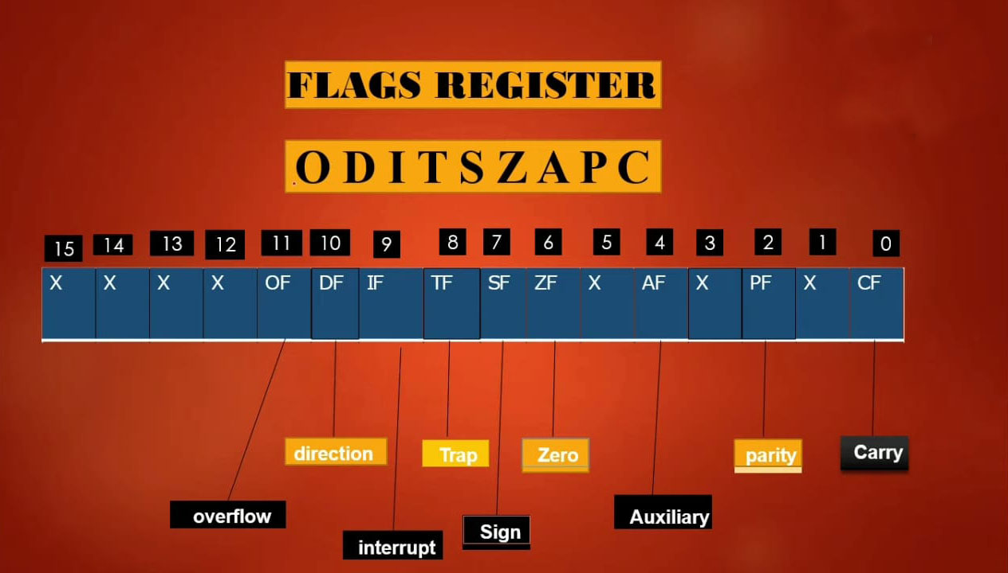

Slide 6
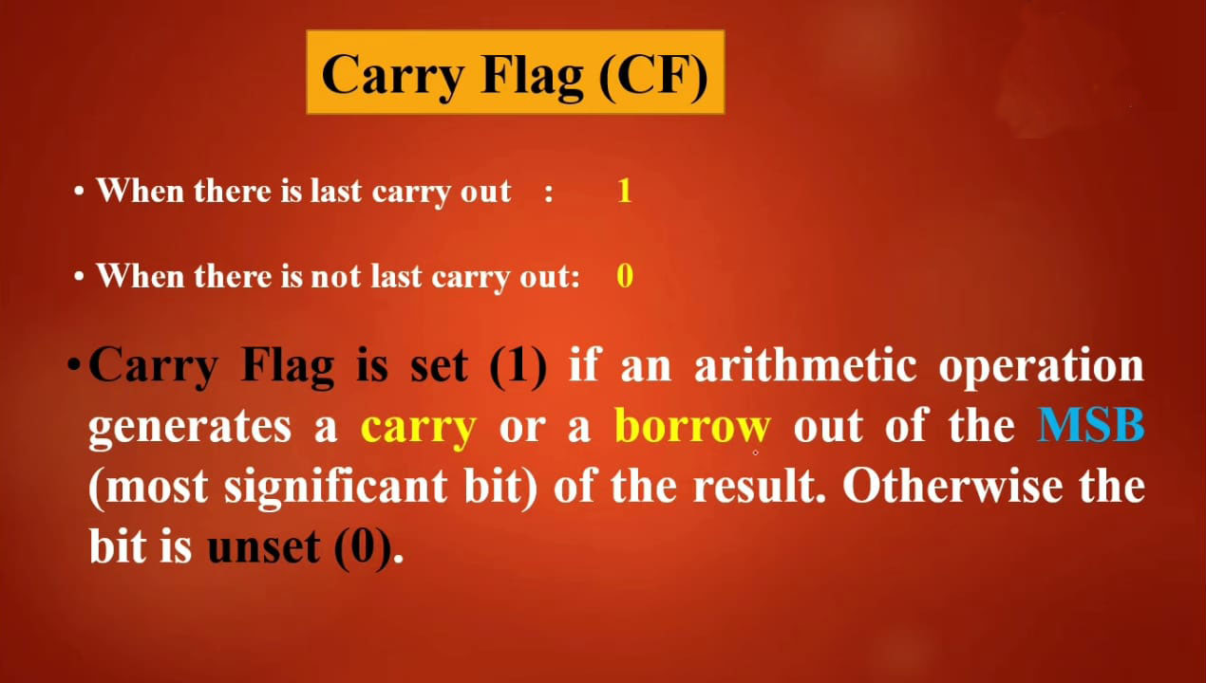

Slide 7
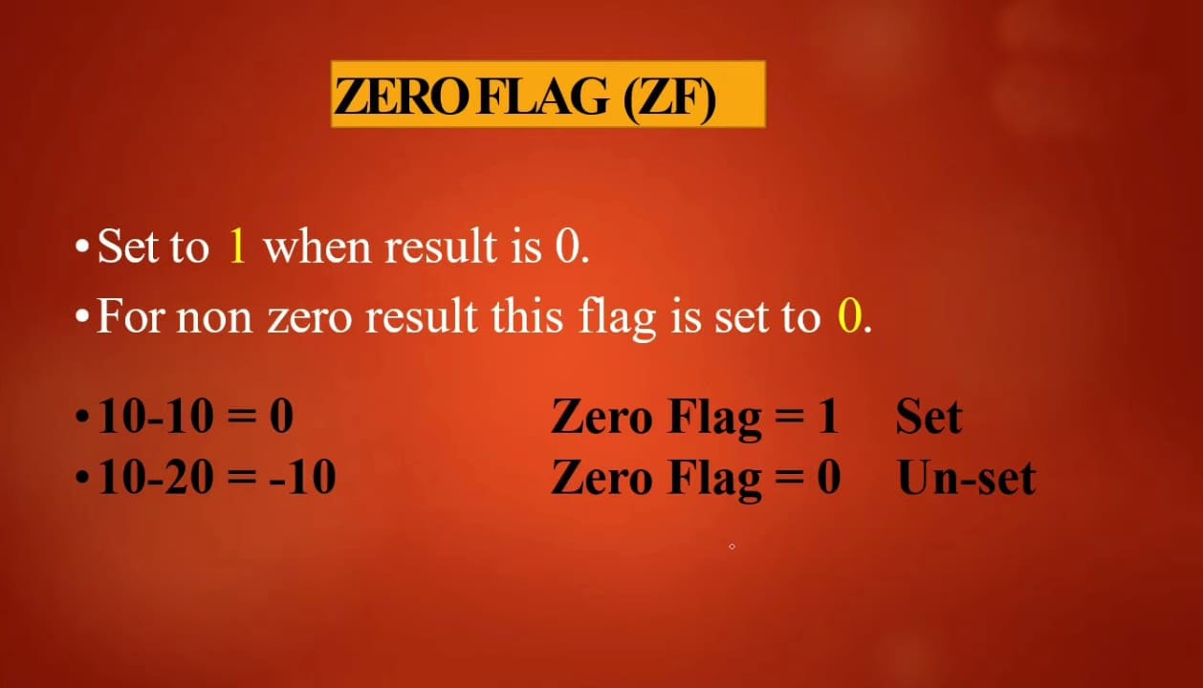

Slide 8
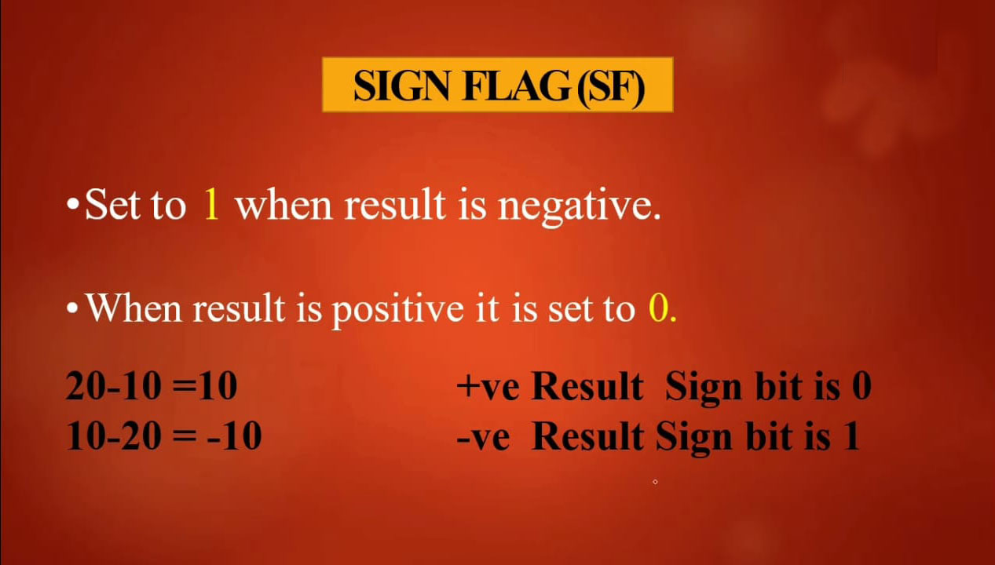

Slide 9
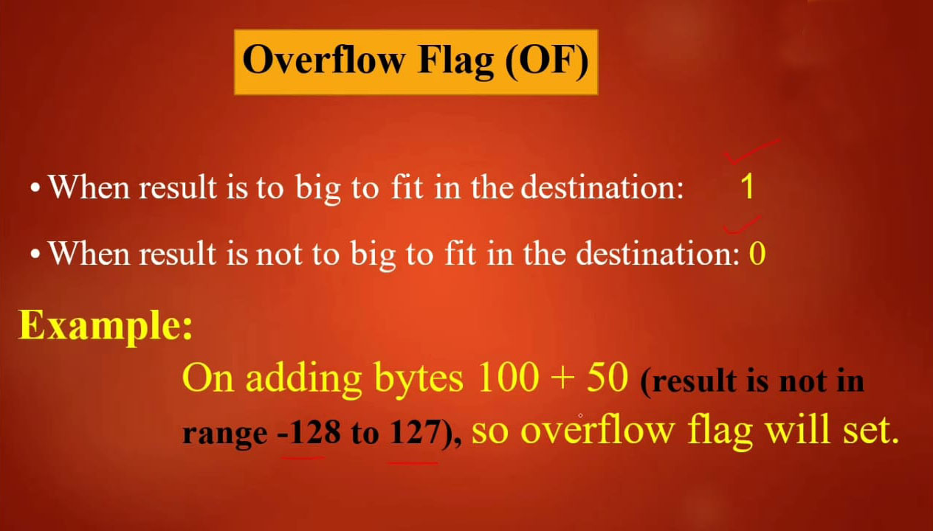

Slide 10
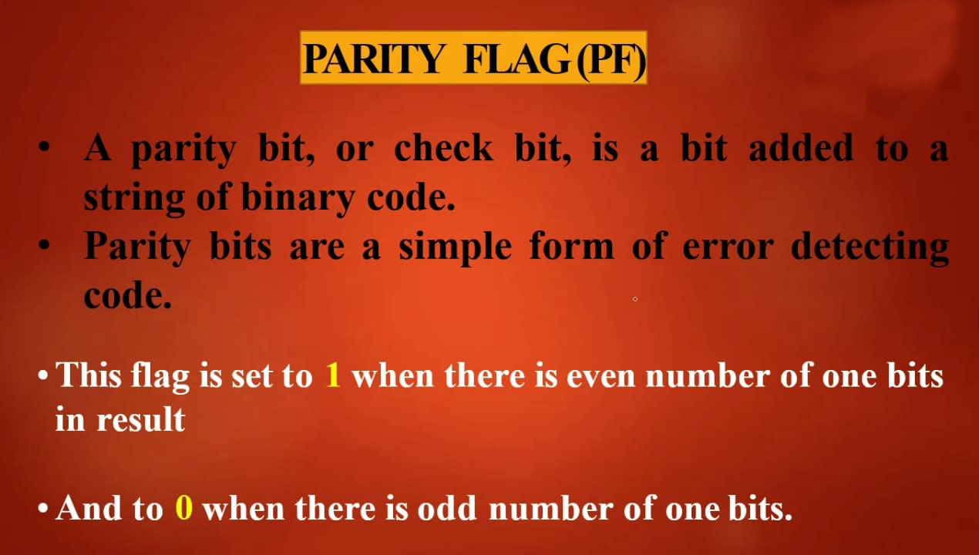

Slide 11
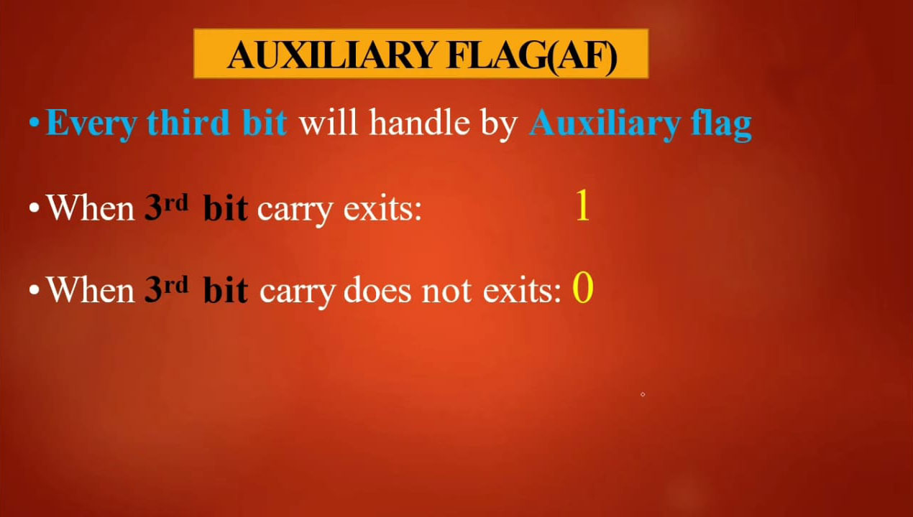

Slide 12
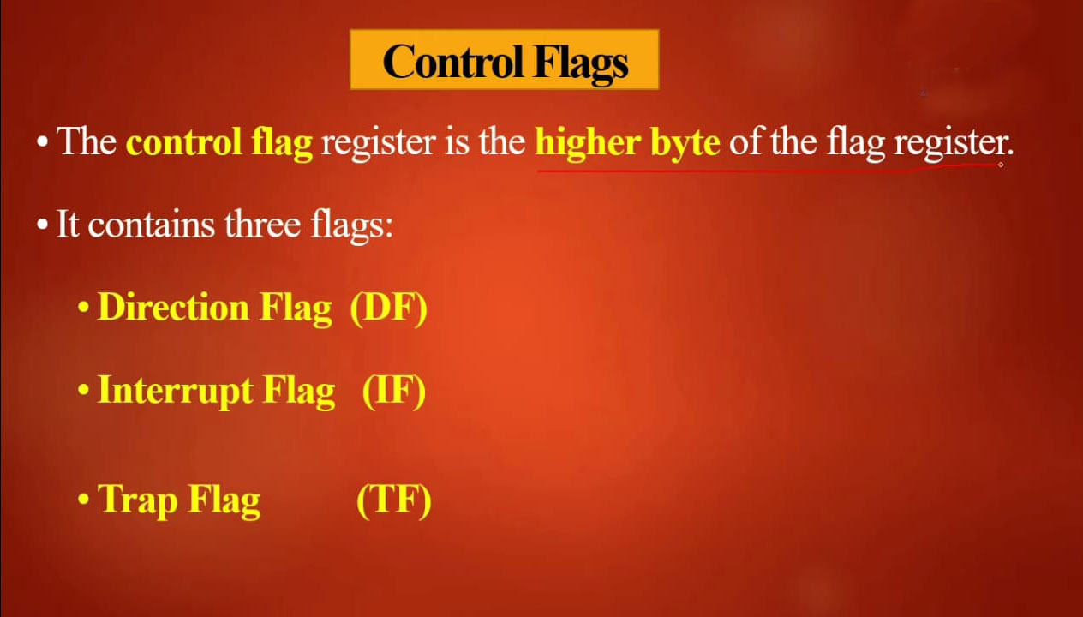

Slide 13
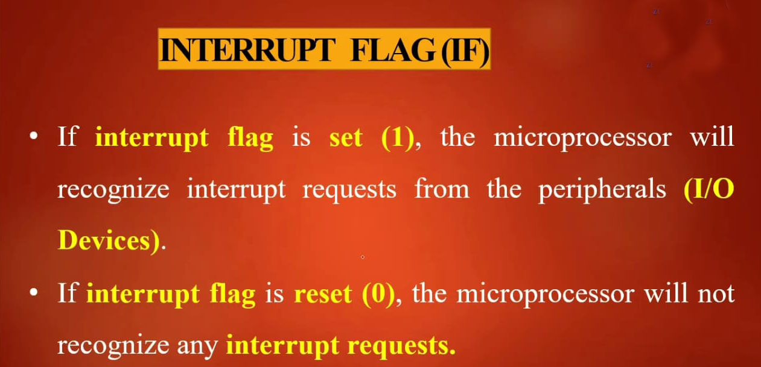

Slide 14
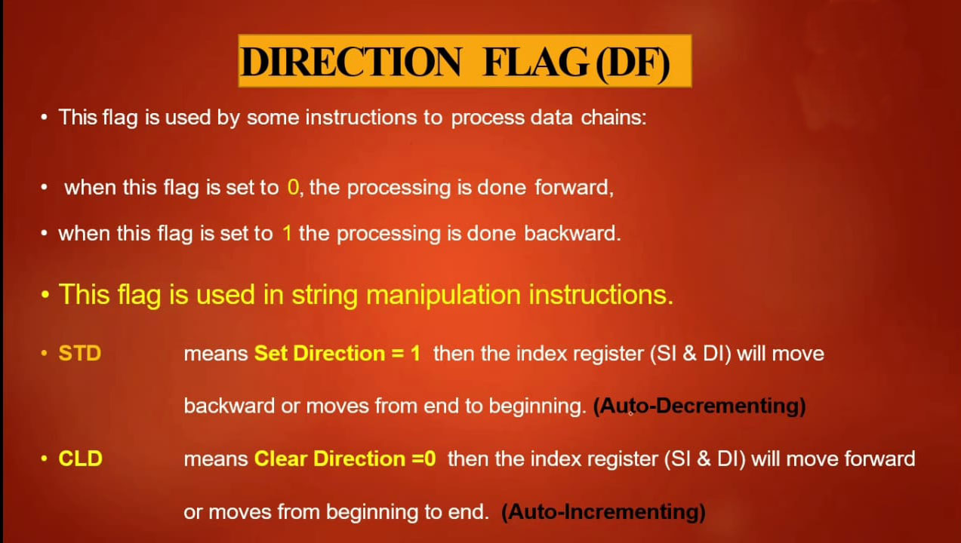

Slide 15
